Slide 1
Bluebells Painting
September
Gallery

Slide 2
Ava and Harry

Slide 5
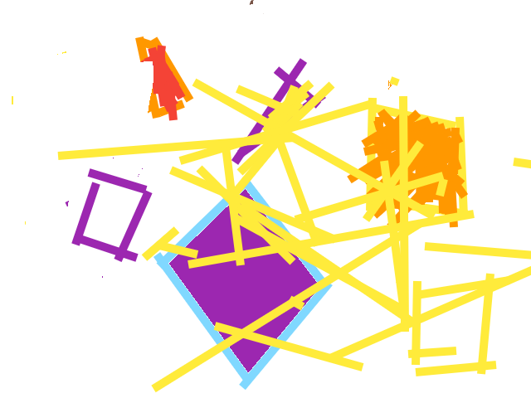
Millie, Zephie and Felicity

Slide 6
Arthur and Zayn

Slide 7
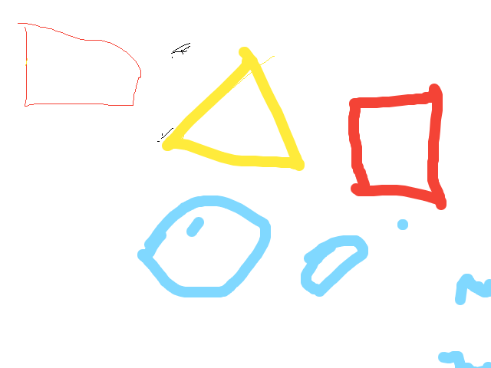
Saijishvi

Slide 8
Bonnie and Kaya

Slide 9
Oakley

